Slide 1


Kingdom Season

Slide 2

Abstract
‏Kingdom season app to keep track of events .The Kingdom Season includes dozens of events, including exhibitions, arts and concerts from around the world. And kingdom season app came to inform its user about the events, their dates, and an overview of each event. The app informs you of when and where the event starts and provides precise details about the services available. You can follow any event to find out information about it in the form of mobile notifications. The application is available in Arabic and in many international languages for both Android and iPhone mobiles. And it includes everything you would like to know about the activities that will be held throughout the duration of the Kingdom season

Slide 3

Introduction
In our application, the main idea is to make users find the events faster. We used multiple interaction styles to make the application more familiar and easier to the users to use and to be user friendly, there are many methods we put like choose the language sign in/out, user information, the menu page that include the calendar, reservation, account and settings section.
Our application helps the user in reservation method it saves the user's time and make the whole process to be done in few minutes .it informs you of when and where the event starts and provides precise details about the services available. The user can see pictures of the place before booking a ticket. It enables online reservation with different payment methods to facilitate payment and the user can save the credit card for next time. The user can turn on the notifications to receives information about new events and activities. The application available in Arabic and English .It will be held in the Riyadh region.

Slide 4
Problems
1.It does not accommodate more than 100 thousand users at one time.
2.Don’t know if there’s enough tickets available.
3.Your reservation can’t be guaranteed without invoice.
4.Some people don’t know that some event don’t allow kids.
5.Long waiting list for restaurants/ buying ticket

Slide 5
Background Information & Related Work
Our application focuses on 4 main section:
Calendar , reservation , account and setting.
Our application is known by its ease of using and access to it quickly through a download on the phone and the possibility of communicating with us. There are many application like ours for e.g. (enjoy Saudi / Riyadh season) but our application inform the user about the event, their date, and overview about it, events are divided to categories you can find the nearest event to you and easily find all needed information in one page. In other hand, the application is not multi-languages only (Arabic / English) so the non-Arabic or the tourist will have some issues with the application.

Slide 6
User Interface, Implementation and Testing
Our application is called kingdom season it is designed for online reservation for activities and events. It will simplify the reservation process and save the user time. It is for people who love to enjoy the life.

Slide 7
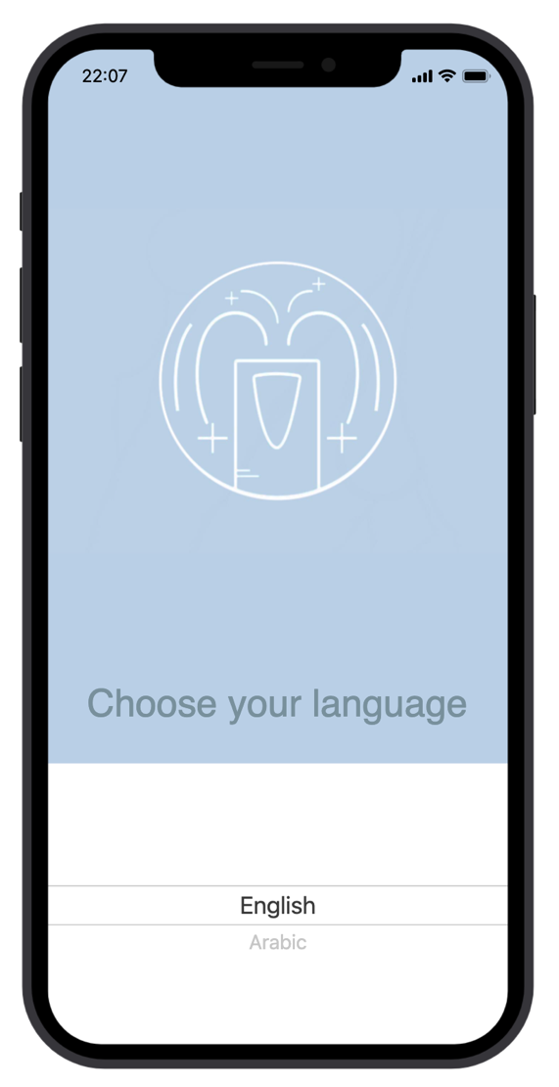
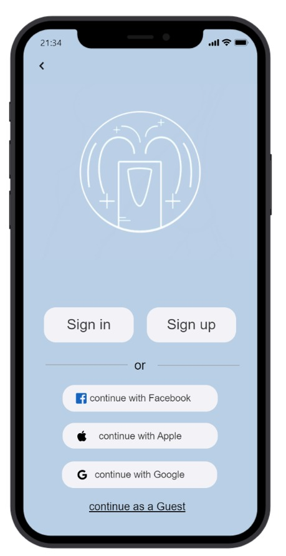
User Interface, Implementation and Testing
This is the home screen it will appear to the user once he chose the language. It contains the application logo, sign in, sign up. If the user want to speed the sign in process he can choose among (Facebook, Google ,Apple) accounts or he can complete as a guest by pressing the text below. The user can go to the previous page by press the back icon in the upper lift.

Slide 8
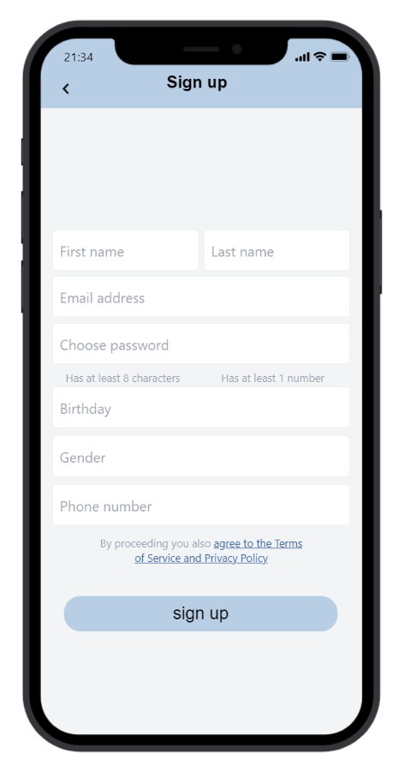
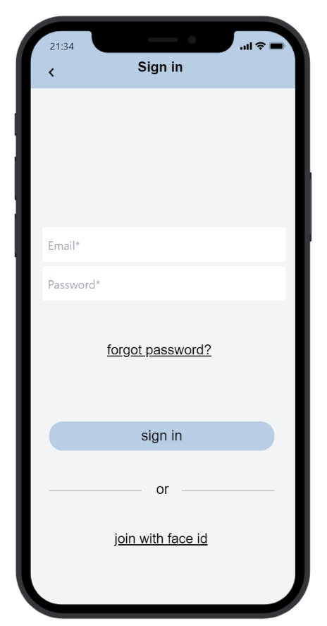
User Interface, Implementation and Testing
After choosing a Sign up the user will enter the following data: first name, last name, email address ,password , Birthday, Gender and Phone Number.Also when the user click sign up will agree to the terms of services and privacy policy.
As for when Sign in, the user will enter Email and Password

Slide 9
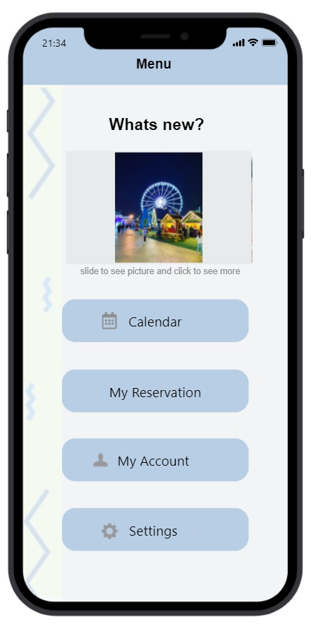
User Interface, Implementation and Testing
After the sign in or sign-up process this screen will appear to the user which is the menu of our application. It contains what's new it shows some photo about all activities, calendar, my reservation, my account and settings. If the user clicks on any of those section, he will go to the screen that he clicked.

Slide 10
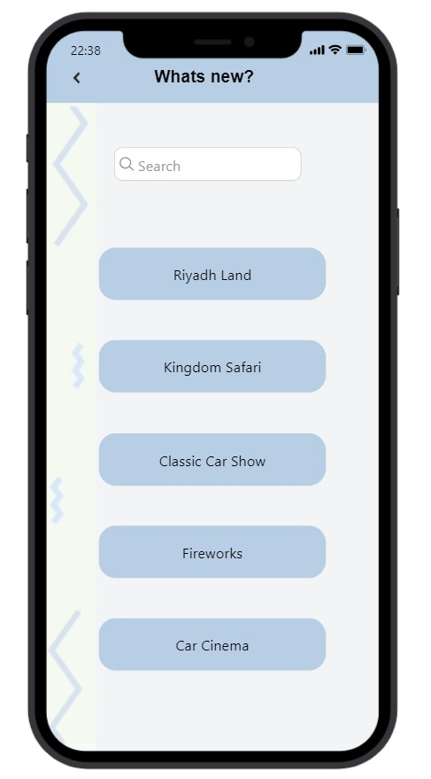
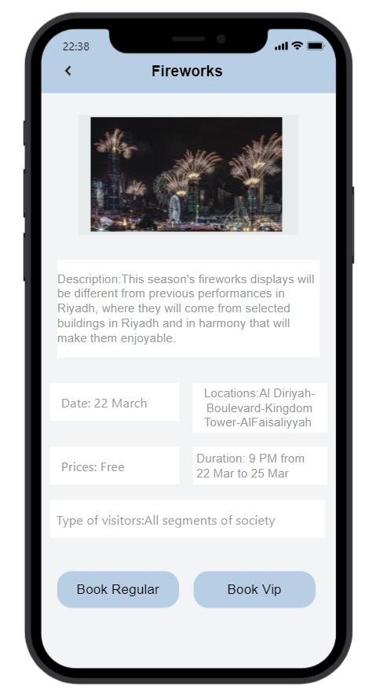
User Interface, Implementation and Testing
If the user clicks on one of the photos in what's new section this screen will appear which is what's new screen. It contains many activities and a section for searching if he chooses one of these activities he will moved to the new screen. The screen is for specific activity he chose it has some photos of the place, description, prices and dates. If the user wants to book, he will click on one of the below buttons to choose the ticket type

Slide 11
User Interface, Implementation and Testing
Through the event page, the user can book by pressing the booking button for an event and either it is a regular category or vip category and then choose the number of tickets he wants and pay by card or pay via Apple Pay.

Slide 12
User Interface, Implementation and Testing
Payment by card requires the card number, the type of card, the name of the card holder and the expiry date, and there is also a button through which it can save the card information for any other booking, also inserts the location information and mobile number.

Slide 13
User Interface, Implementation and Testing
The calendar is the second section in the menu, the user goes through the calendar to choose the available date they want and display the events on that day

Slide 14
User Interface, Implementation and Testing
If the user click on the my reservation in the menu he will be moved to the my reservation screen which includes the status about the reservation. The last buttons will move the user to the previous reservations

Slide 15
User Interface, Implementation and Testing
My previous reservation screen contains the previous reservation. When he click on the one of these activities new screen will appear. The new screen is about the activity that includes description, date, and the price. There is question to ask the user to rate the service and field to write a comment if he finished he will click on the check below.

Slide 16
User Interface, Implementation and Testing
When you click on the my account on the menu page, this page will appear, which enables the user to modify the following data: email, first name, last name, phone number, date of birth and password . also you can see your wallet

Slide 17
User Interface, Implementation and Testing
The wallet contains the current balance, cash back to be stored in the wallet, and also my cards contain previously added cards, and the user can add more than one new credit card
Then he enters the payment card information like:
Card type, Card number , Name on card , Expiry date and Cvv

Slide 18
User Interface, Implementation and Testing
When you click on the change password on the my account page, this page will appear, which enables the user to modify the password. She asks him to write a new word and rewrite it and save it

Slide 19
User Interface, Implementation and Testing
The setting page you can decide which language you briefer, and can turn on the notification. The contact us section so the user can contact the support team as soon as possible in the end the sing out log out of the application.

Slide 20
Data of the Project:
The data that will be stored in the database is user information, card information, and event information that is booked, such as the number of people booked per day and their age.

Slide 21
Results have to be tested for correctness:
Task Name | Task Time | Number of Errors | Comments | Suggestion to improve Task Design
1.Sign up | 3 min | 1 | I think the required registration information is exaggerated and mostly unimportant. | Put only important information about registration
2.Sign in | 2 min | 0 | Add entry through the national id number | Add the ID number in the registration information so that the person in the next few times can log in through it
3.Log in as guest | 5 s | 0 | Access easy, easy and without complications | -
4.Forget password | 2 min | 0 | I forgot my personal email password, I had trouble retrieving the password for the account, and I didn't find an email to retrieve it. | Increase the ways to retrieve your account password by texting
5.Browse photos | 20 s | 0 | Easy browsing photos and they were great pictures of events | -
6.Booking | 1 min | 0 | Easy to book events | Send a text message to save your booking information and access it when you access the event site
7.Payment | 2 min & 30s | 2 | Increase payment methods, especially payment when you arrive at the event site | Increase payment methods.
8.Rate | 1 min | 1 | I guess the evaluation of the events is not accurate. | I think it's more accurate to put the rate from 1 to 10
9.Add card | 4 min | 0 | There's a glitch in writing the card number, which requires me to rewrite the number twice. | Reset the card addition settings.
10.Sign out | 30 s | 0 | it was easily and smoothly | -

Slide 22
Conclusion:
In conclusion, we would like our system to be one of the most used systems in the future because it provides many benefits to the user such as: usability, effectiveness, clear information, efficiency, excellent services , high quality and the extent of customer satisfaction . All these features help the user to request again, and it also provides all the required sections for the user, including to provide all recreational activities and restaurants with a specific time to sell their tickets and arrange reservations. Finally, the most important point in our design it will develop the user in the future and provide him with comfort and guarantee.

